Slide 1
Azure Search
Bianca Furtuna
Technical Evangelist
@Fur_Bi

Slide 2
What is Azure Search?
Search-as-a-Service
No infrastructure management and no need of becoming search experts
Add search to your apps using API or .NET SDK

Slide 3
Features
Powerful Queries
Language support – 56 languages
Lucene Analyzers : stemming, stop words
Microsoft Analyzers: lemmatisation
Search suggestions
Hit highlighting
Faceted navigation
Geo-spatial support

Slide 4
Typical Workflow
Provision service
Create index
Index data
Search

Slide 5
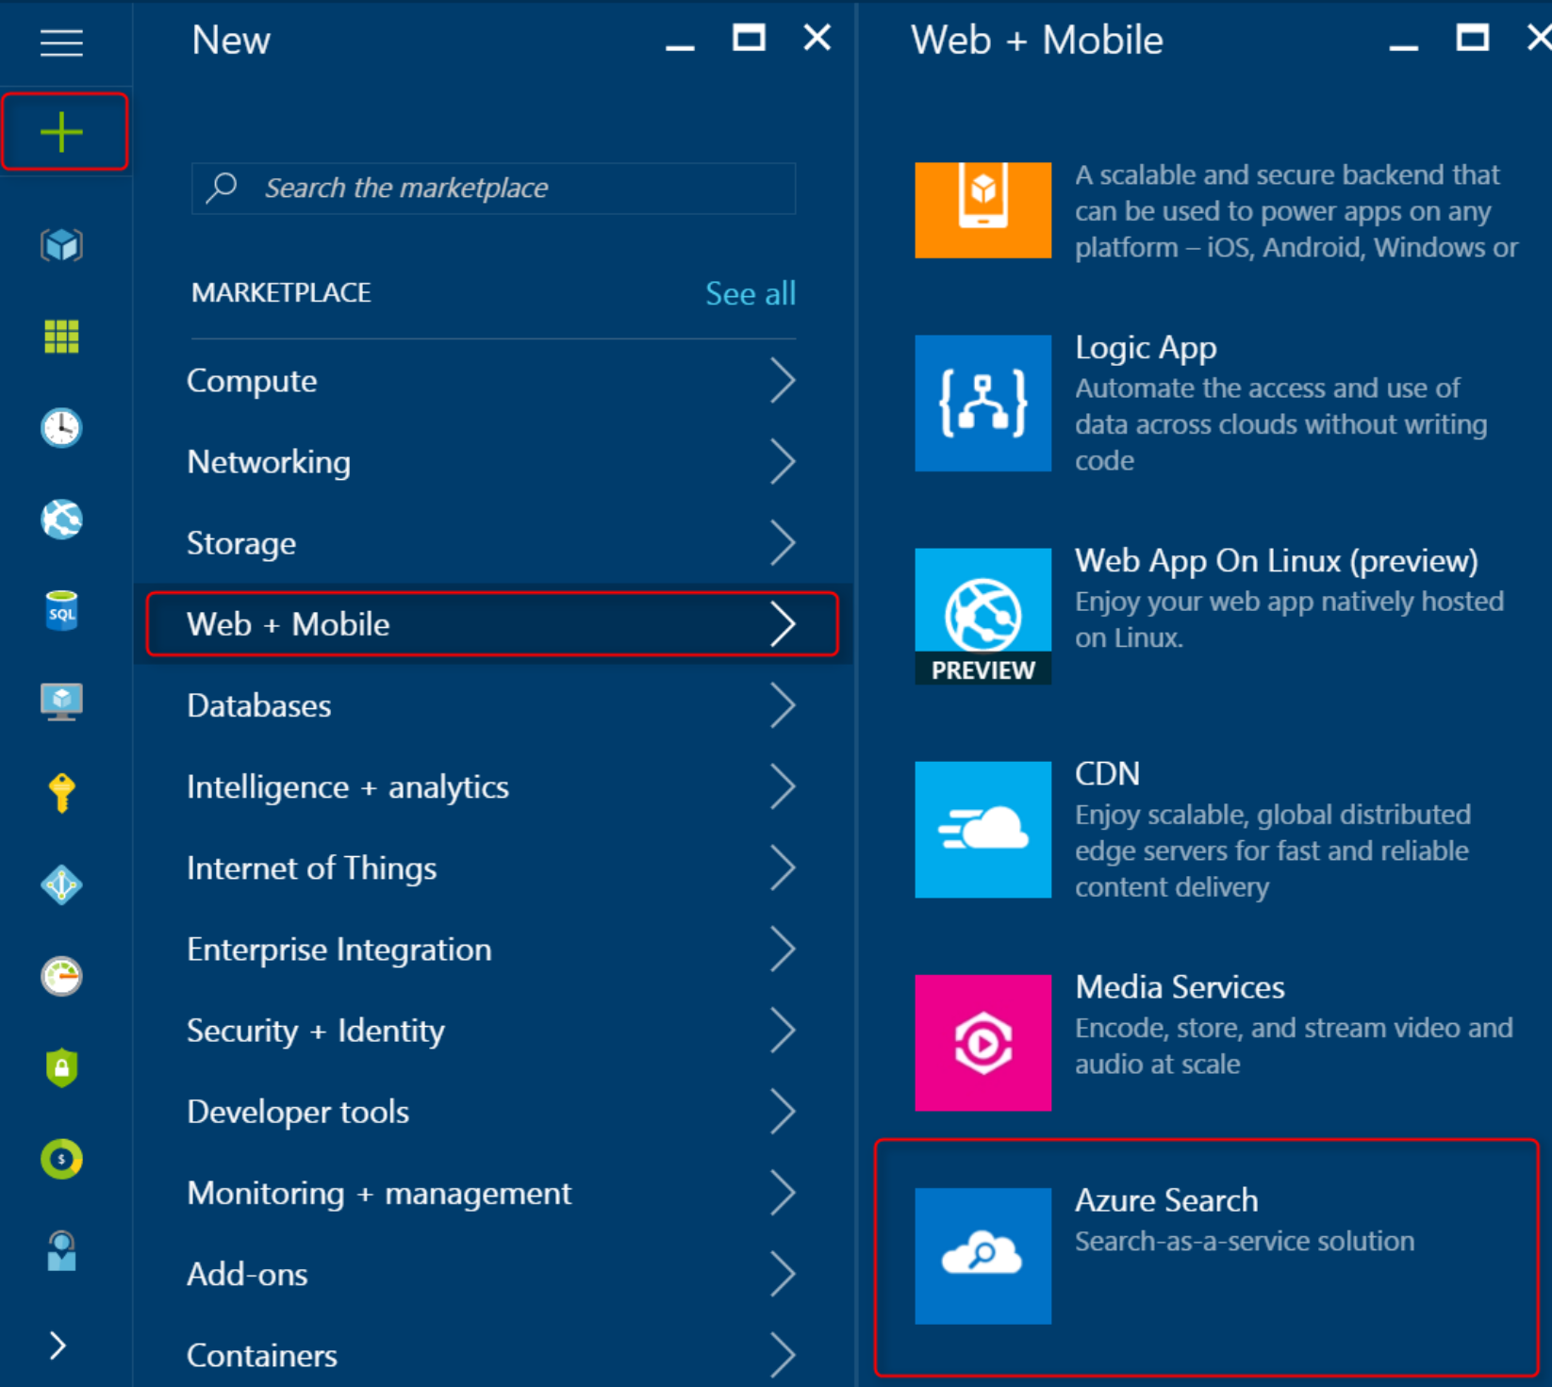
Provision Service
Provision service
Create index
Index data
Search
Using Azure Portal or the Azure Resource Management API
Scale in two dimensions:
Replicas – more capacity
Partitions – more storage

Slide 6
Create Index
Provision service
Create index
Index data
Search
Index = container of data, “table” that accepts queries
Define index schema – name, type, attributes of each field
Schema created via Azure Portal, .NET SDK or APIs

Slide 7
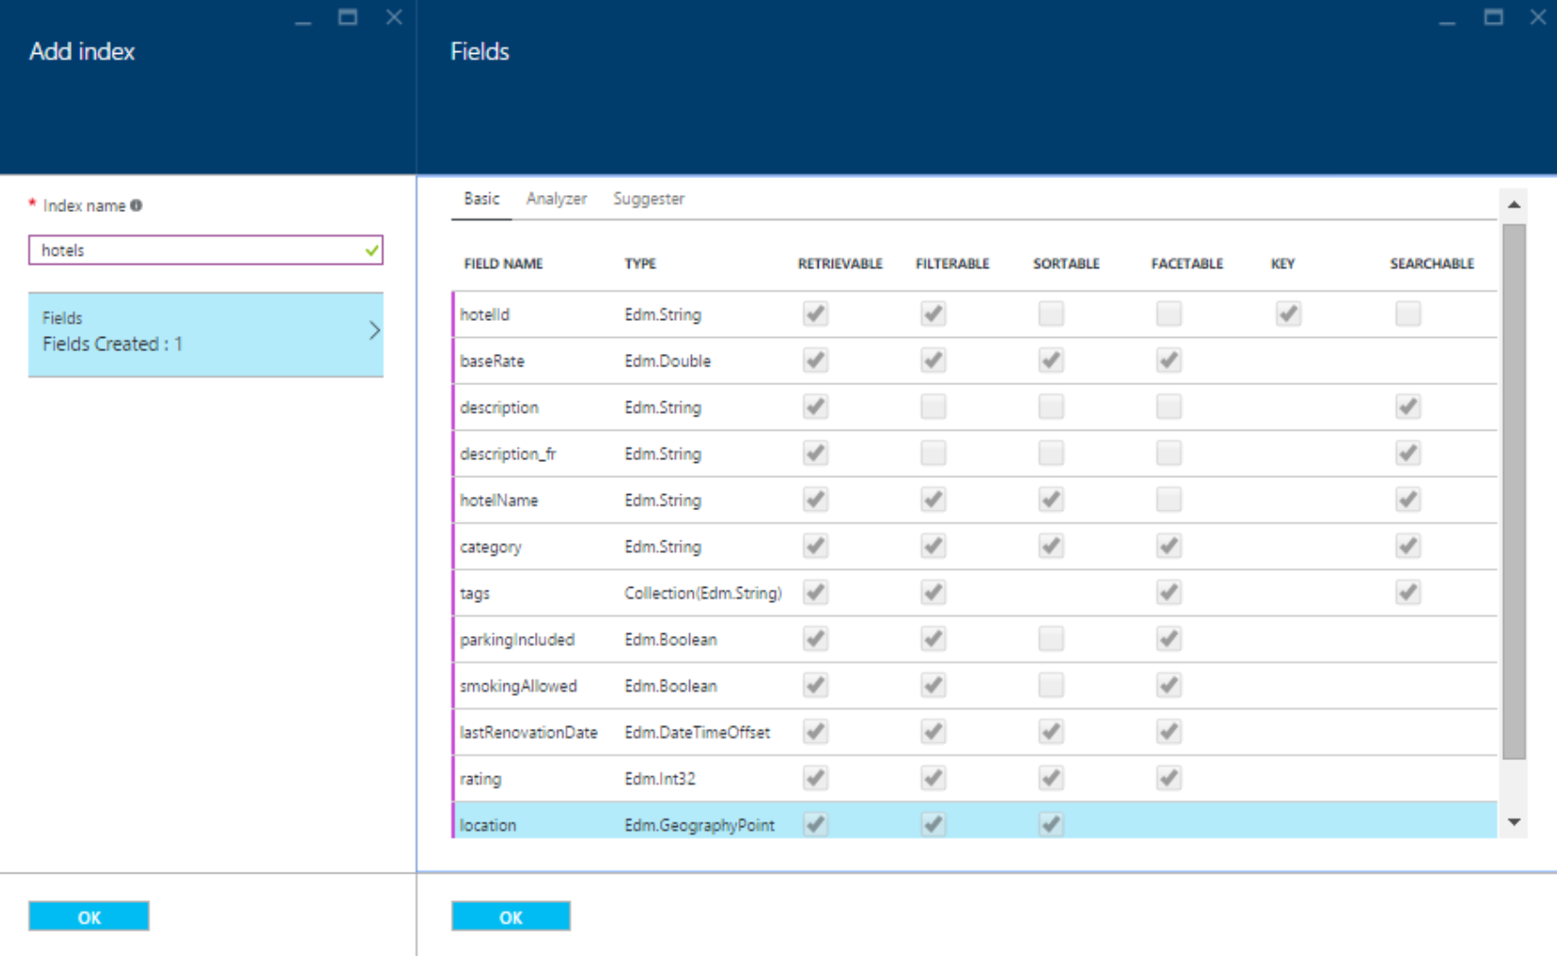
Create Index
Provision service
Create index
Index data
Search
Notes:
Taken from documentation: https://docs.microsoft.com/en-us/azure/search/search-create-index-portal

Slide 8
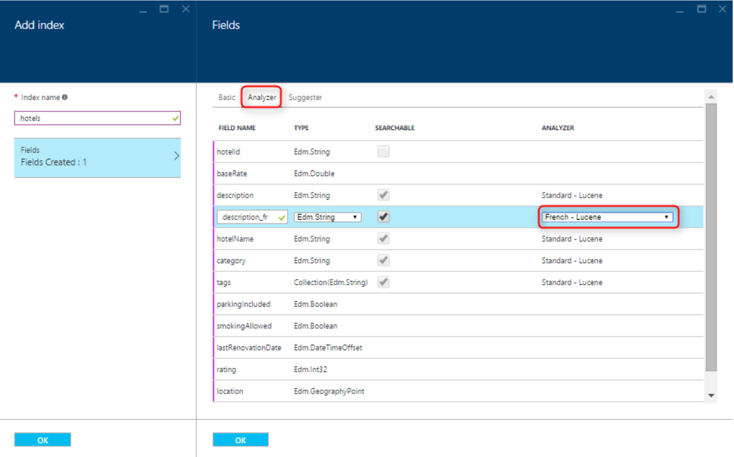
Create Index
Provision service
Create index
Index data
Search
Notes:
Taken from documentation: https://docs.microsoft.com/en-us/azure/search/search-create-index-portal

Slide 9
Index data
Provision service
Create index
Index data
Search
Push/pull model to upload data to the index
Push data to an index – indexing APIs
Send updated documents to an index
Send data from any dataset using JSON format
Pull into an index – using indexers
Blob storage, Table storage, DocumentDB, Azure SQL and SQL Server in VM
Point at the data source, define policy
Scheduling

Slide 10
Search
Provision service
Create index
Index data
Search
Issue search queries: Azure Portal, APIs or .NET SDK
Simple query syntax
Lucene query syntax

Slide 11
Pricing
Free – shared service
Basic – small production workloads
Standard – multiple configurations and capabilities

